Slide 1



How to implement and train a cognitive chatbot using the Bluemix cloud platform
Meetup Bluemix Paris # 20
@42born2code
Yves Le Cléach
Bluemix Business Rules IBM France Lab
December 14, 2016

Slide 2
Filing a claim online

Slide 3
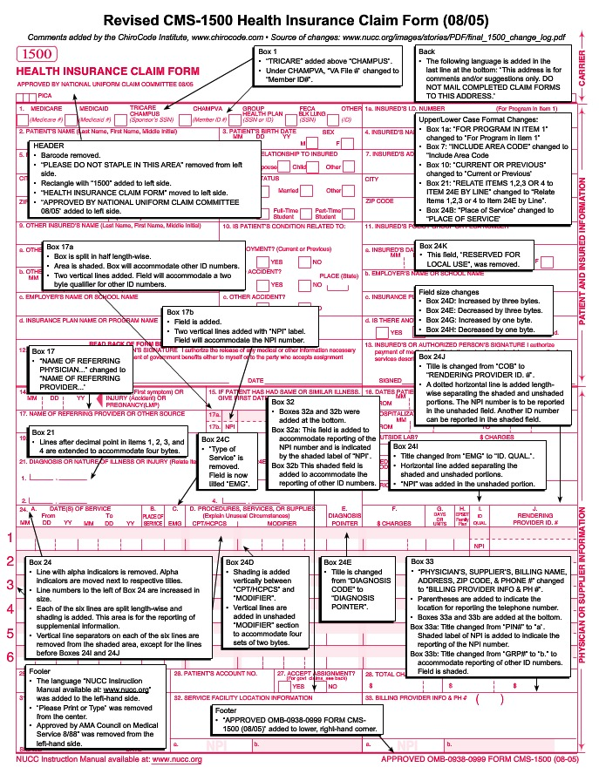
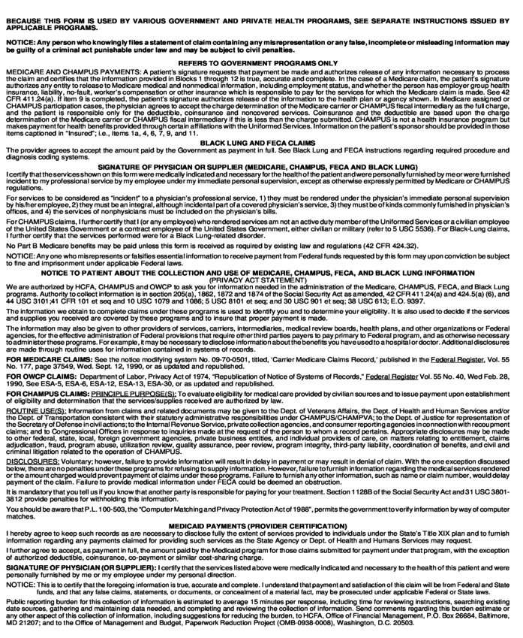
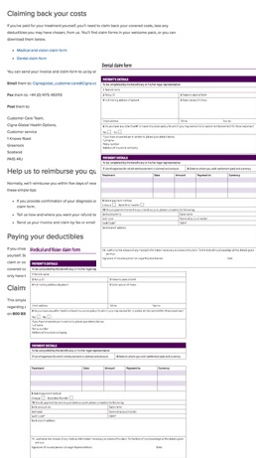
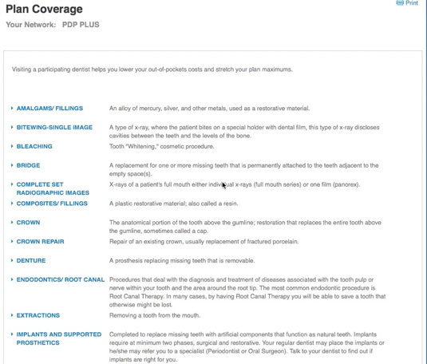

Slide 4

How about a chatbot instead?

Slide 5






CUSTOMER
Responsive
Web App
or
iOS APP SWIFT
BOT MICROSERVICE
Cloudant (DB)
WATSON CONVERSATION

Slide 6
Let’s chat with Watson Conversation

Slide 7
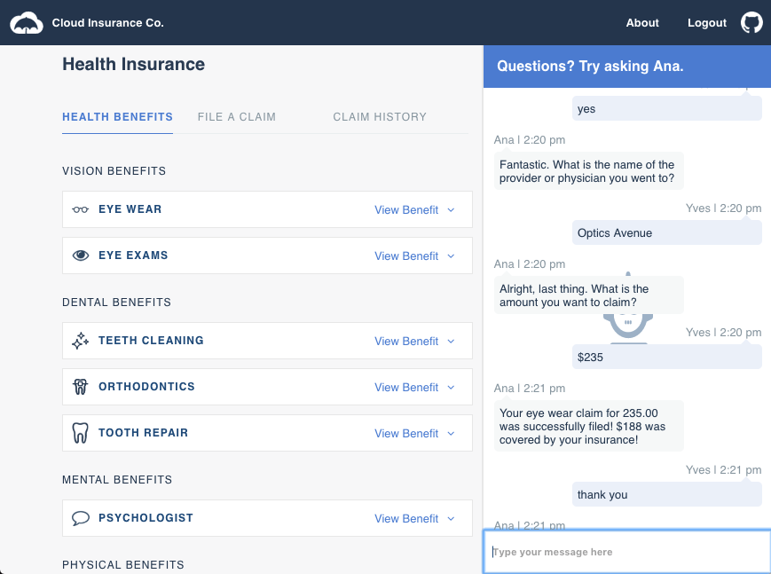

Slide 8
Admin dashboard live with Watson Tone Analyzer

Slide 9


CUSTOMER
iOS APP SWIFT
BOT MICROSERVICE
DASHBOARD MICROSERVICE
DASHBOARD
ADMIN
Cloudant (DB)
WATSON CONVERSATION
WATSON TONE ANALYZER

Slide 10
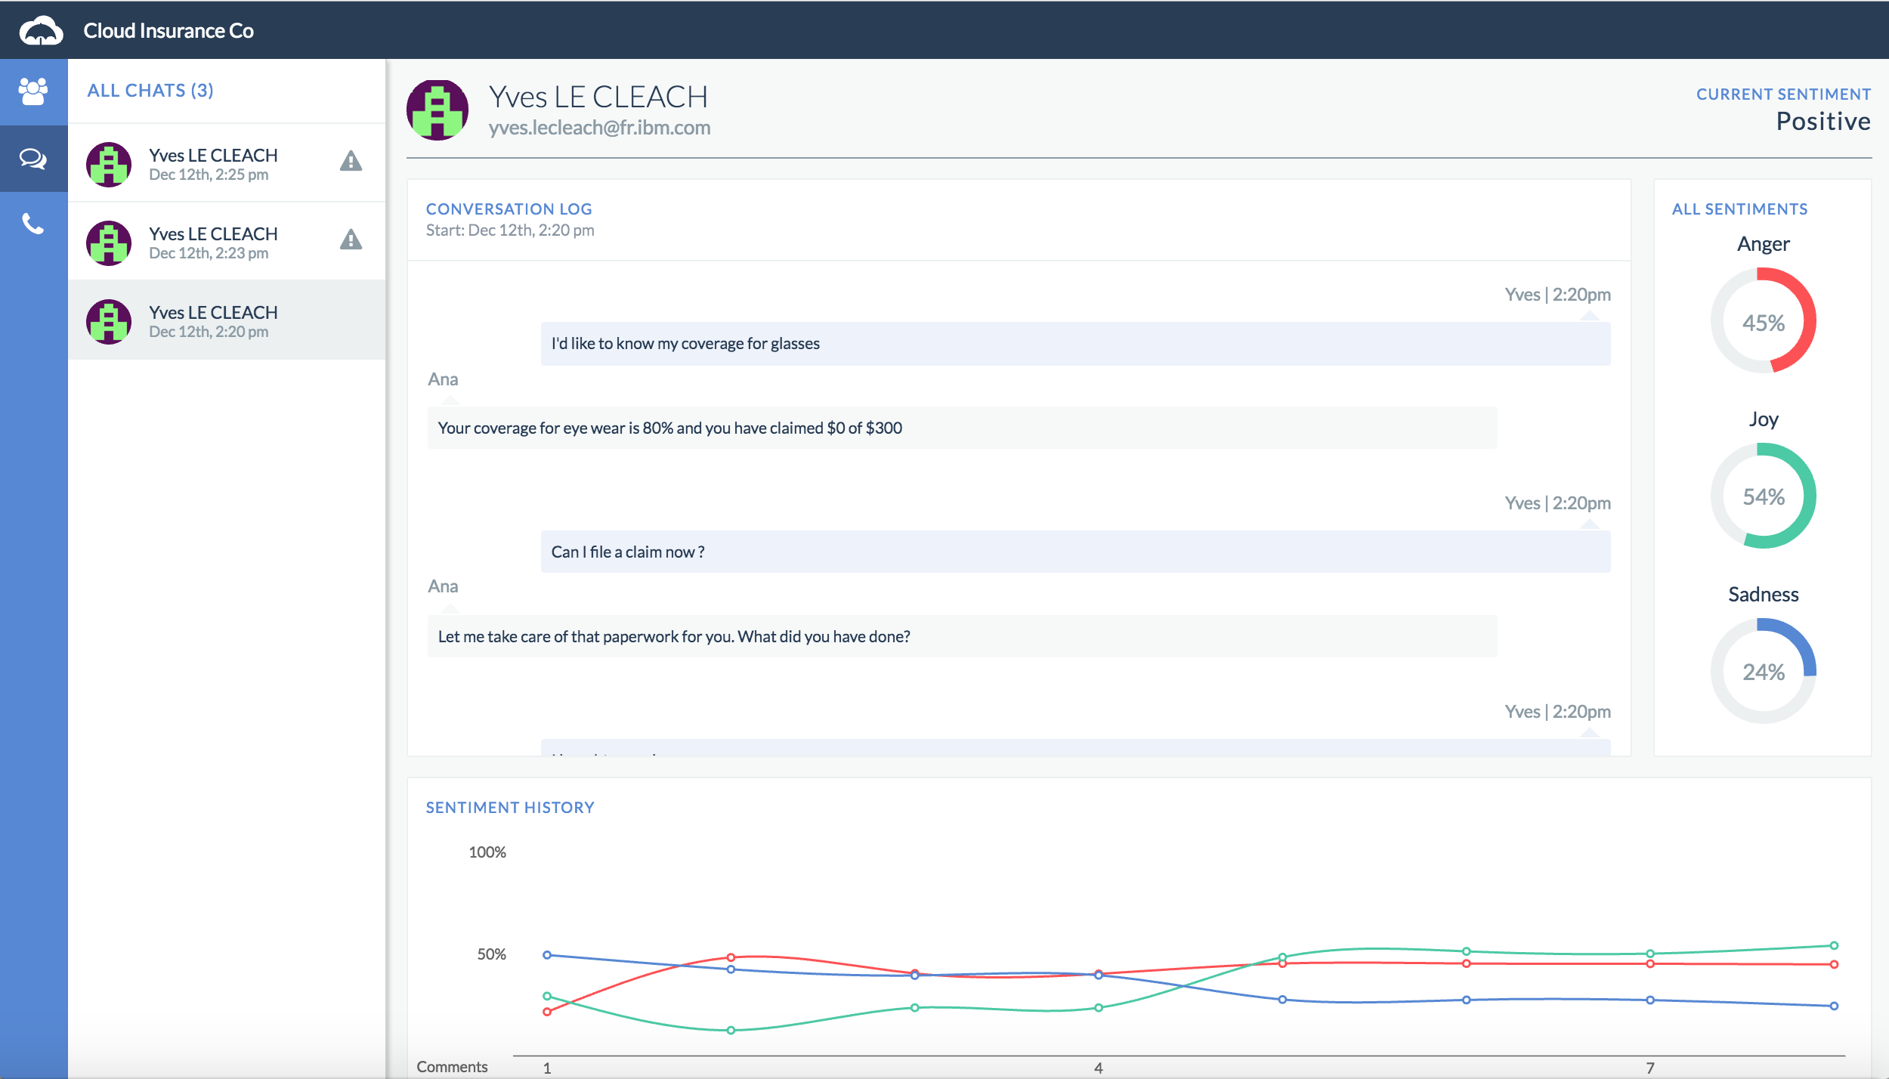

Slide 11
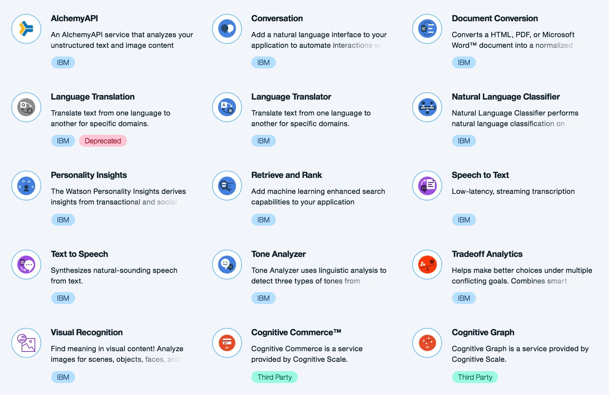
What’s next?

Slide 12
In Conclusion
Bluemix allows very rapid assembly of cloud and mobile apps
Services can be used “off the shelf” and combined easily
Cognitive services can free human support from routine work and allow them to concentrate on higher business value

Slide 13
Learn More
IBM Bluemix:
https://www.ibm.com/bluemix
Code for the Demo:
https://github.com/IBM-Bluemix/cloudco-insurance
Watson Conversation Service:
https://www.ibm.com/watson/developercloud/conversation.html
Watson Tone Analyzer:
https://www.ibm.com/watson/developercloud/tone-analyzer.html

Slide 14
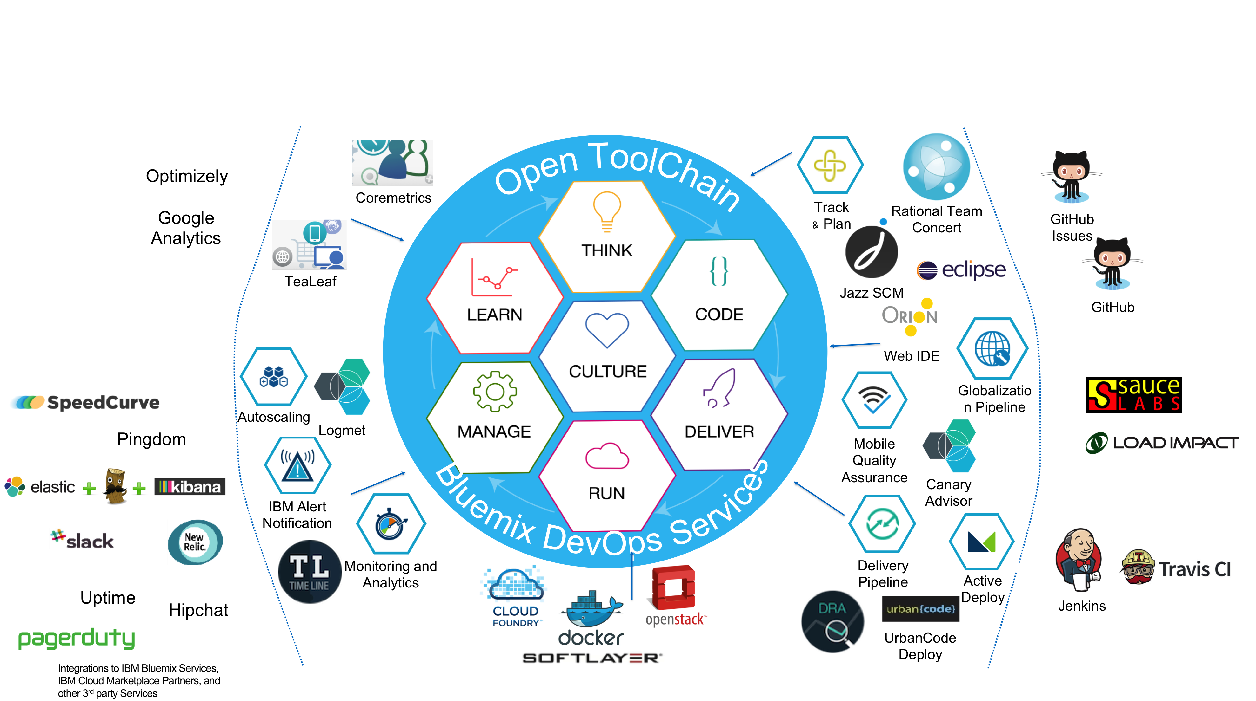
Open Toolchain
Rapidly setup and manage an integrated delivery toolchain following DevOps best practices

